Slide 1
Battery Charging and Use selector switch
<-on off->
<-on off->
<-on off->
5V DC Charger IN
3.7V Batt
Relay Reset
Common
Batt +
Batt -
OUT -
B -
B +
OUT +
Relay
Relay IN +
Relay OUT +
Batt – 18650 [vipon] 3.7V 1800mAh
Batt – 18650 [vipon] 3.7V 1800mAh
Batt – 18650 [vipon] 3.7V 1800mAh
IN +
3.7V to 5V
OUT +
5V to 3.3 V
OUT -
IN -
ON/OFF
USB
USB
5V DC USB Power Out
Power Pins
Batt Sense | 5V | GND | 3.3V

Slide 2
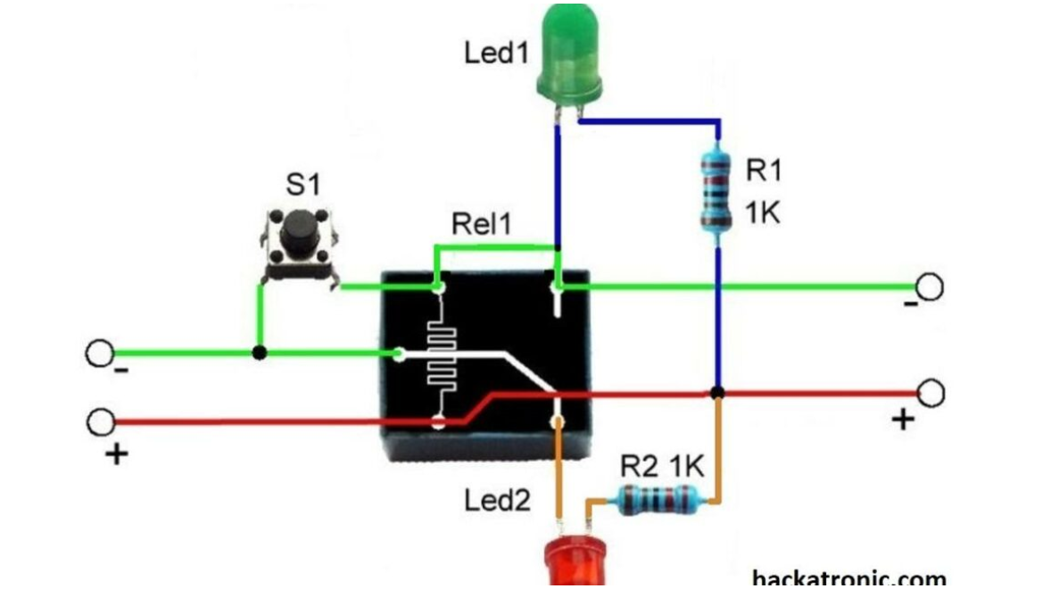
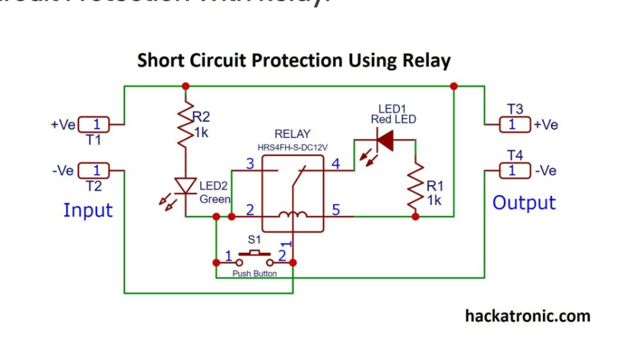
Short Circuit Relay Board

